Slide 1





Objects and Classes
Using Objects and Classes Defining Simple Classes
Fundamentals of Programming with C#
O
O
SoftUni Team
O
O
Technical Trainers
P
P
Software University
http://softuni.bg

Slide 2
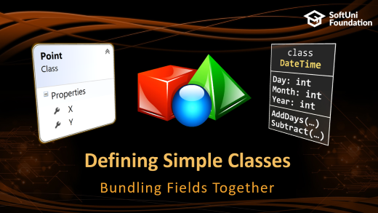
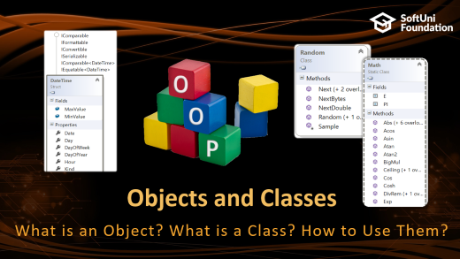
Table of Contents

Slide 3
Have a Question?
sli.do CSharpFund

Slide 4
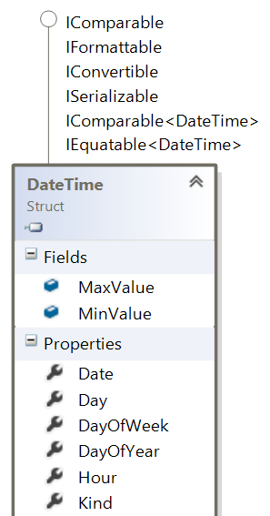
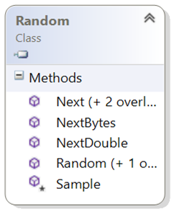
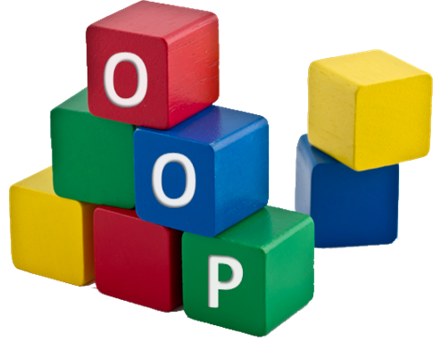
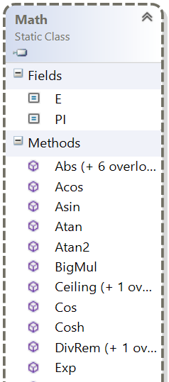
Objects and Classes
What is an Object? What is a Class? How to Use Them?

Slide 5
Objects
Create a new object of type DateTime
An object holds a set of named values
E.g. birthday object holds day, month and year
Creating a birthday object:
Object name
var day = new DateTime(
2017, 6, 19); Console.WriteLine(day);
Birthday
Day = 27
Month = 11
Year = 1996
Object properties
The new operator creates a new object
var birthday = new { Day = 27, Month = 11, Year = 1996 };

Slide 6
Classes
In programming, classes provide the structure for objects
Act as template for objects of the same type
Classes define:
Data (properties, attributes), e.g. Day, Month, Year
Actions (behavior), e.g. AddDays(count), Subtract(date)
One class may have many instances (objects)
Sample class: DateTime
Sample objects: peterBirthday, mariaBirthday

Slide 7
Classes vs. Objects
Objects
Classes
object peterBirthday
Object name
Class name
class DateTime
Day = 27
Month = 11
Year = 1996
Object data
Day: int
Month: int
Year: int
Class data (properties)
object mariaBirthday
Object name
AddDays(…)
Subtract(…)
Class actions (methods)
Day = 14
Month = 6
Year = 1995
Object data

Slide 8
Objects and Classes – Example
DateTime peterBirthday = new DateTime(1996, 11, 27);
DateTime mariaBirthday = new DateTime(1995, 6, 14);
Console.WriteLine("Peter's birth date: {0:d-MMM-yyyy}",
peterBirthday); // 27-Nov-1996
Console.WriteLine("Maria's birth date: {0:d-MMM-yyyy}",
mariaBirthday); // 14-Jun-1995
var mariaAfter18Months = mariaBirthday.AddMonths(18);
Console.WriteLine("Maria after 18 months: {0:d-MMM-yyyy}",
mariaAfter18Months); // 14-Dec-1996
TimeSpan ageDiff = peterBirthday.Subtract(mariaBirthday);
Console.WriteLine("Maria older than Peter by: {0} days",
ageDiff.Days); // 532 days

Slide 9

Class Data
Storing Data Inside a Class

Slide 10
Fields
Class fields have type and name
class Dice {
string type;
int sides;
int[] rollFrequency;
Person owner;
…
}
Fields can be of any type

Slide 11
Access modifiers
Classes and class members have modifiers
Access modifiers define visibility
Class modifier
public class Dice {
private int sides;
public int Roll() { … }
}
Fields should always be private!
Member modifier

Slide 12
Properties
Used to create accessors and mutators (getters and setters)
Field is hidden
class Dice {
private int sides;
public int Sides
{
get { return this.sides; }
set { this.sides = value; }
}
}
Getter provides access to field
Setter provide field change

Slide 13
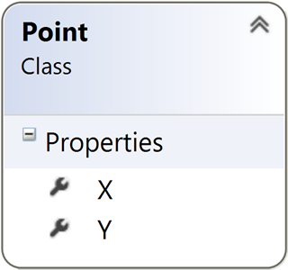

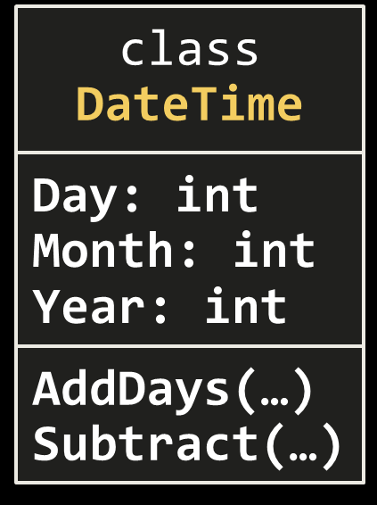
Defining Simple Classes
Bundling Fields Together

Slide 14
Defining Simple Classes
Simple classes hold a few fields of data, e.g.
Class name
Class properties (hold class data)
class Point
{
public int X { get; set; }
public int Y { get; set; }
}
Point p = new Point() { X = 5, Y = 7 };
Console.WriteLine("Point({0}, {1})", p.X, p.Y);
Creating а new object p of class Point

Slide 15
Problem: Distance between Points
Write a method to calculate the distance between two points p₁ {x₁, y₁} and p₂ {x₂, y₂}
Write a program to read two points (given as two integers) and print the Euclidean distance between them
double CalcDistance(Point p1, Point p2)
{ … }
3 4
6 8
5.000
3 4
5 4
2.000
8 -2
-1 5
11.402

Slide 16
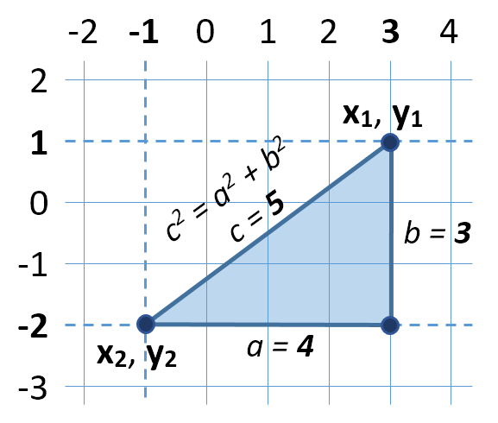

Solution: Distance between Points
Let's have two points p₁ {x₁, y₁} and p₂ {x₂, y₂}
Draw a right-angled triangle
Side a = |x₁ - x₂|
Side b = |y₁ - y₂|
Distance == side c (hypotenuse)
c² = a² + b² (Pythagorean theorem)
Distance = c = $\sqrt{a^{2}+b^{2}}$

Slide 17
Solution: Distance between Points
static void Main()
{
// Reads both points separately
Point p1 = ReadPoint();
Point p2 = ReadPoint();
// Calculate the distance between them
double distance = CalcDistance(p1, p2);
// Print the distance
Console.WriteLine("Distance: {0:f3}", distance);
}

Slide 18
Solution: Distance between Points(2)
static Point ReadPoint()
{
int[] pointInfo = Console.ReadLine().Split()
.Select(int.Parse).ToArray();
Point point = new Point();
point.X = pointInfo[0];
point.Y = pointInfo[1];
return point;
}
static double CalcDistance(Point p1, Point p2)
{
int deltaX = p2.X - p1.X;
int deltaY = p2.Y - p1.Y;
return Math.Sqrt(deltaX * deltaX + deltaY * deltaY);
}

Slide 19
Problem: Sales Report
Write a class Sale holding the following data:
Town, product, price, quantity
Read a list of sales and print the total sales by town:
5
Sofia beer 1.20 160
Varna chocolate 2.35 86
Sofia coffee 0.40 853
Varna apple 0.86 75.44
Plovdiv beer 1.10 88
Order the results by town name
Plovdiv -> 96.80
Sofia -> 533.20
Varna -> 266.98

Slide 20
Solution: Sales Report
class Sale
{
public string Town { get; set; }
// TODO: add the other fields …
public decimal Quantity { get; set; }
}
static Sale ReadSale()
{
string[] items = Console.ReadLine().Split();
return new Sale() {
Town = items[0], …, Quantity = decimal.Parse(items[3])
};
}

Slide 21
Solution: Sales Report (2)
static Sale[] ReadSales()
{
int n = int.Parse(Console.ReadLine());
Sale[] sales = new Sale[n];
// TODO: read the sales …
}
…
Sale[] sales = ReadSales();
var towns = sales.Select(s => s.Town).Distinct().OrderBy(t => t);
foreach (string town in towns)
{
var salesByTown = sales.Where(s => s.Town == town)
.Select(s => s.Price * s.Quantity);
Console.WriteLine("{0} -> {1:f2}", town, salesByTown.Sum());
}
Can you make this faster using SortedDictionary
<string, decimal>?

Slide 22
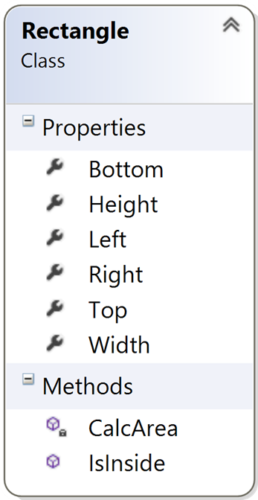

Defining Simple Classes
Live Exercises in Class (Lab)

Slide 23

Constructors
Object Initialization

Slide 24
Constructors
Special methods, executed during object creation
public class Dice
{
private int sides;
public Dice()
{
this.sides = 6;
}
}
Overriding default constructor

Slide 25
Constructors (2)
You can have multiple constructors in the same class
public class Dice
{
private int sides;
public Dice()
{
this.sides = 6;
}
public Dice(int sides)
{
this.sides = sides;
}
}
Constructor without parameters
Constructor with parameters

Slide 26
Constructor Chaining
Constructors can call each other
public class Dice
{
private int sides;
public Dice()
: this (6)
{
}
public Dice(int sides)
{
this.sides = sides;
}
}
Calls constructor with parameters

Slide 27

Summary
Objects holds a set of named values
Classes define templates for object (data + actions)
Creating and using objects:
Defining and using classes:
DateTime d = new DateTime(1980, 6, 14);
Console.WriteLine(d.Year);
class Point {
public int X { get; set; }
public int Y { get; set; }
}
Point p1 = new Point() { X = 5, Y = -2 };
Point p2 = new Point(5, -2);

Slide 28







Fundamentals of Programming – Objects & Classes
https://softuni.bg/courses/programming-fundamentals

Slide 29
License
This course (slides, examples, demos, videos, homework, etc.) is licensed under the "Creative Commons Attribution-NonCommercial-ShareAlike 4.0 International" license

Slide 30





Trainings @ Software University (SoftUni)
Software University – High-Quality Education, Profession and Job for Software Developers
softuni.bg
Software University Foundation
http://softuni.foundation/
Software University @ Facebook
facebook.com/SoftwareUniversity
Software University Forums
forum.softuni.bg

